Slide 1

SVKM’s Institute of Technology, Dhule Department of Information Technology
Major Project Presentation
On
“Self-Checkout Smart Store System”
By
Name Roll
Vineet Chopade 11
Piyush Kumar Agrawal 02
Bhagyesh Katkar 18
Omprakash Bhamare 08
Guide
Ms. Rubi Mandal

Slide 2
SVKM’s Institute of Technology, Dhule Department of Information Technology
Project Title : Self-Checkout Smart Store System
Project Domain: Machine learning, Computer vision, Internet of Things.
Self-Checkout Smart Store System

Slide 3
Introduction
The self-checkout store system is a retail solution aimed at revolutionizing the traditional shopping experience. This innovative concept leverages advanced technology and automation to provide customers with a seamless and efficient checkout process.
The self-checkout store utilizes computer vision, machine learning, Sensor technology, and Digital Payment System to enable customers to shop freely without the need for traditional checkout counters or cashier assistance.
Self-Checkout Smart Store System

Slide 4
Problem Statement
Customers and retailers both face issues like lost revenue, reduced customer loyalty, waste of time, and product abandonment due to long queues in stores. To develop a system which resolves these issues to enhance the shopping experience, increase customer satisfaction, and boost sales by providing a seamless, secure, and user-friendly self-checkout process.
Self-Checkout Smart Store System

Slide 5
Aim and Objectives of the Project
The project aims to address common challenges faced by both customers and retailers, such as long queues, cashier errors, and inventory management inefficiencies to provide customers with a seamless and efficient checkout process.
Project objectives:
Retailers can reduce labour costs
Minimize checkout waiting time
Improve customer satisfaction
Self-Checkout Smart Store System

Slide 6
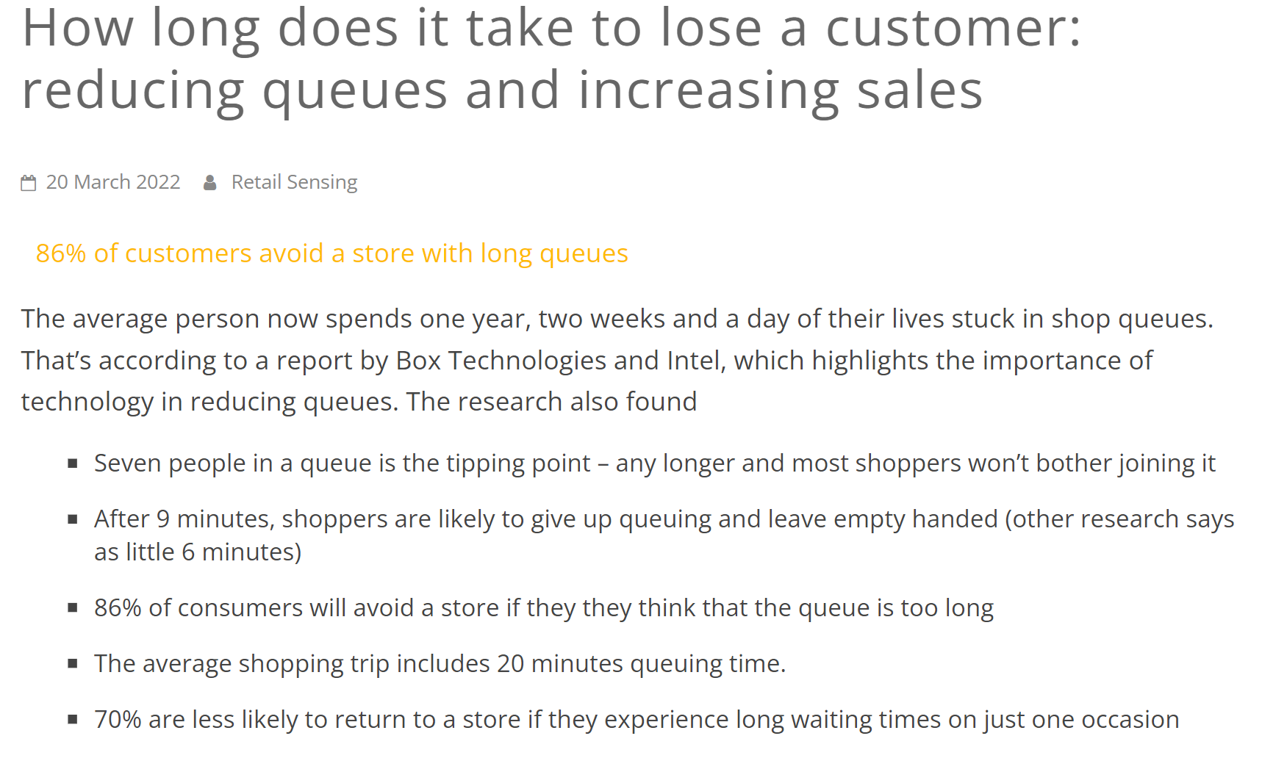
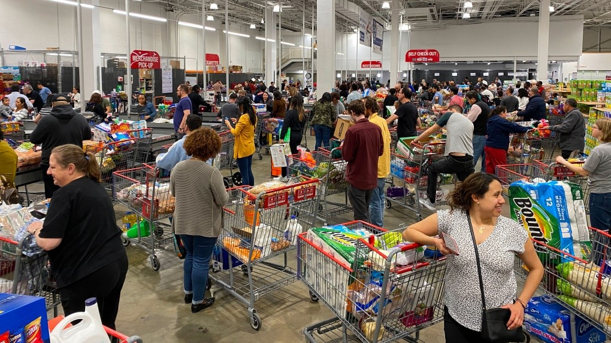
Motivation
Self-Checkout Smart Store System

Slide 7
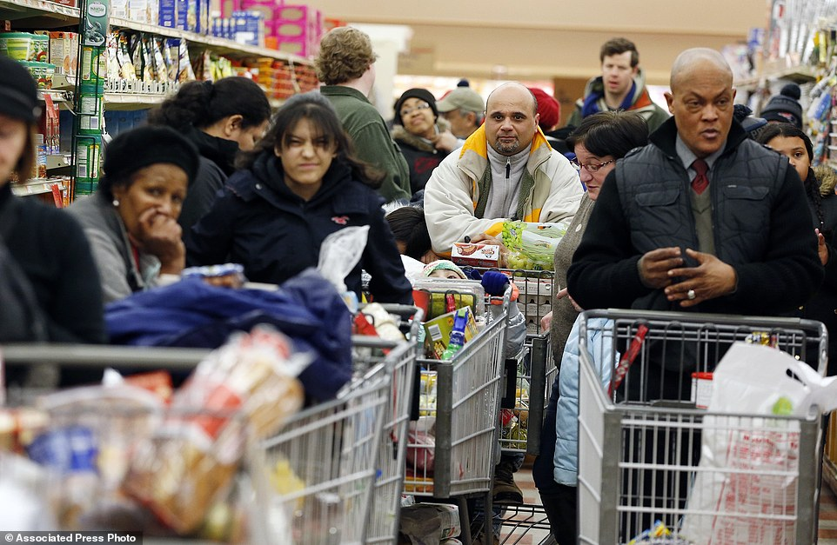
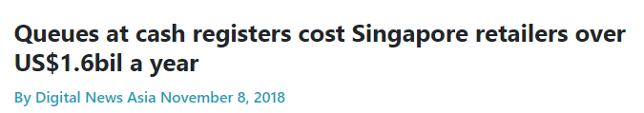
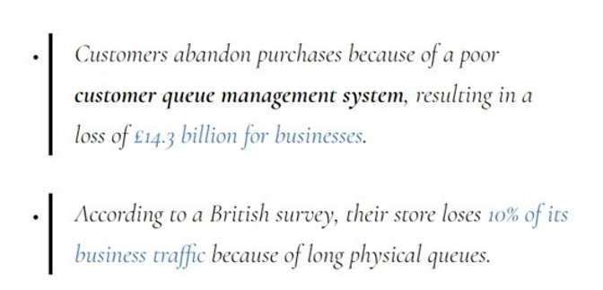
Motivation
Self-Checkout Smart Store System

Slide 8
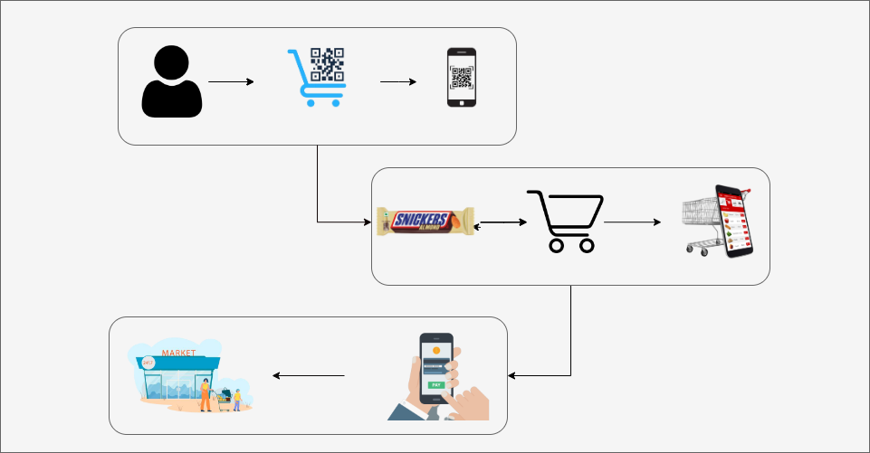
Working Model
Customer have to scan QR code on the Cart which will link the Cart to his Account.
2. The items added to the Cart will also be added to Customer's Virtual Cart.
3. Bill will be generated and customer can pay through mobile application.
Self-Checkout Smart Store System

Slide 9
Applications
Retail Chains and Grocery Stores: The most direct application is implementing the smart store system in traditional retail chains and grocery stores. This would allow these stores to offer a cashier less, automated shopping experience to their customers, reducing checkout wait times and enhancing customer convenience.
Airport Shops and Convenience Stores: Implementing smart store system in airport shops and convenience stores could significantly improve the shopping experience for travelers. With quick, automated transactions, passengers can easily grab items they need without worrying about missing their flights.
Shopping Malls and Department Stores: Large shopping malls and department stores could integrate smart store system technology to create an enhanced shopping experience for customers, especially during busy shopping seasons.
Bookstores and Libraries: Automated checkout systems could be introduced in bookstores and libraries, enabling patrons to borrow or purchase books with minimal hassle.
Self-Checkout Smart Store System

Slide 10
Conclusions
Enhanced Convenience: Self-checkout smart stores provide shoppers with a more seamless and efficient shopping experience. Customers can quickly make payments, and exit the store without waiting in long queues, saving valuable time and reducing frustration.
Improved Customer Satisfaction: With fewer checkout bottlenecks and a user-friendly interface, customers experience higher satisfaction levels when shopping at smart stores. The reduction in human error during the checkout process also contributes to a more positive shopping experience.
Reduced Theft and Fraud: The integration of advanced security measures, such as surveillance cameras, helps minimize theft and fraud instances, improving store profitability and loss prevention efforts.
Contactless Shopping: In growing demand for contactless experiences, self-checkout smart stores offer a safer shopping option, minimizing physical interactions.
Self-Checkout Smart Store System

